Slide 1
COUNTING
Session 8-9
Course : Z0184-Discrete Mathematics
Effective Period : September 2017

Slide 2
These slides have been adapted from:
Susanna S.Epp. (2010). Discrete Mathematics with Applications.4th edition. Thomson Brooks/Cole. USA. ISBN: 9780534359454
Chapter 9
Acknowledgement

Slide 3
On successful completion of this Course, students will be able to:
Learning Objectives
LO 1: Explain the logic of compound and quantified statements and how do to proof
LO 2: Explain and applying Set Theory, Counting method and Number Theory
LO 3: Explain Function, recursion, fuzzy set, Relations and Graph Theory
LO 4: Explain Trees & Graph theory and its application
LO 5: Explain Automata and graph its application in computer science

Slide 4
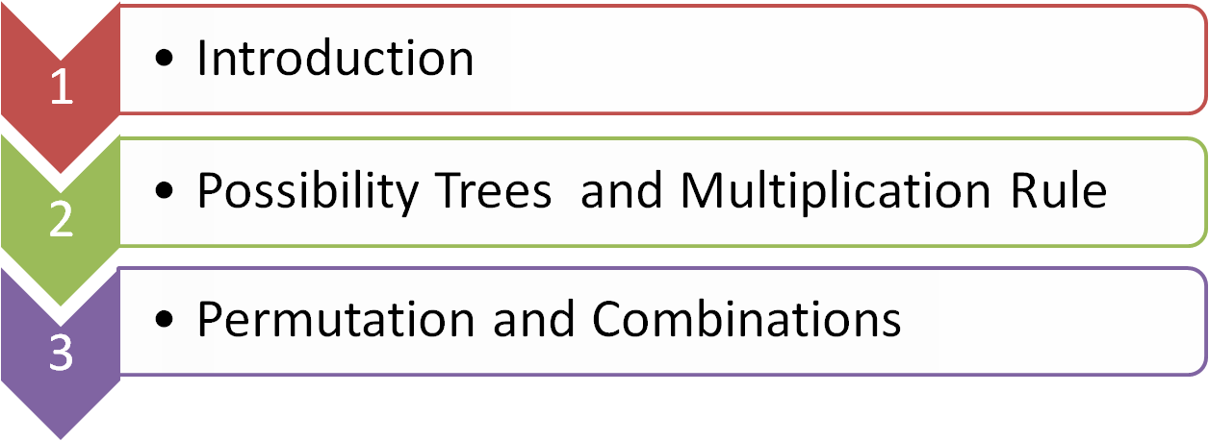


Outline
Addition and Difference Rule
The Binomial Theorem

Slide 5
INTRODUCTION

Slide 6
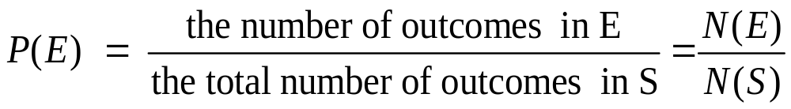
Introduction
Definition
A sample space is the set of all possible outcomes of a random process or experiment.
An event is a subset of a sample space.
Equally Likely Probability Formula
    If S is a finite sample space in which all outcomes are equally likely and E is an event in S, then Probability of E, denoted P(E), is

Slide 7
Example: Deck of Cards
Probabilities for a Deck of Cards
  What is the sample space of outcomes?
  What is the event that the chosen card a black face card?
  What is the probability that the chosen card a black face card?
  Solution:
  N(S) = 52,
  E = { ♠^{K}, ♠^{Q}, ♠^{J}, ♣^{K}, ♣^{Q}, ♣^{J} },
  P(E) = N(E)/N(S) = 6/52

Slide 8
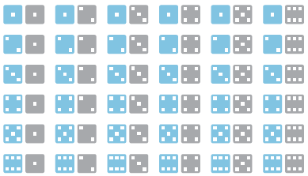
Example: Pair of Dice (1/2)
Rolling a Pair of Dice( a Blue die and a Gray die )
  Use the compact notation to write the sample space S of possible outcomes.
  Use set notation to write the event E that the numbers showing face up have a sum of 6 and find the probability of the event.

Slide 9

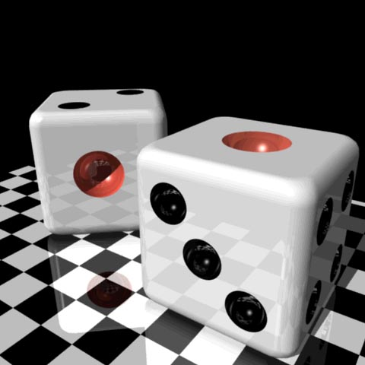
Example: Pair of Dice (2/2)
Solution :
A more compact notation identifies, say, with the string 24, with 53 and so forth.
S = { 11, 12, 13, 14, 15, 16, 21, 22, 23, 24, 25, 26, 31, 32, 33, 34, 35, 36, 41, 42, 43, 44, 45, 46, 51, 52, 53, 54, 55, 56, 61, 62, 63, 64, 65,66 }
E = { 15, 24, 33, 42, 51 }
P(E) = N(E) / N(S) = 5/36

Slide 10
POSSIBILITY TREE & MULTIPLICATION RULE

Slide 11
Possibility Tree
A tree structure is a useful tool for keeping systematic track of all possibilities in situations in which events happen in order
  Example :
  Three officers－a President, a Treasurer, and a Secretary are to be chosen from among four people: Ann, Bob, Cyd, and Dan. Ann cannot be President. Either Cyd or Dan must be Secretary.
  How many ways can the officers be chosen ?

Slide 12
Possibility Tree
Solution :
President
Treasurer
Secretary
C
A
D
B
C
D
8 ways
D
C
A
D
C
B
D
A
C
D
B
C

Slide 13
The Multiplication Rule
  Theorem
  If an operation consist of k steps and
  1st step can be performed in n₁ ways
  2nd step can be performed in n₂ ways (independent with 1’st step)
  …
  k^{th} step can be performed in n_{k} ways (independent with preceding step )
  Then the entire operation can be performed in n₁× n₂ × n₃ × … × n_{k} ways

Slide 14

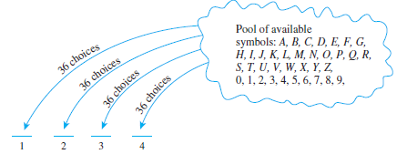

The Multiplication Rule
  Example:
A typical PIN (personal identification number) is a sequence of any four symbols chosen from the 26 letters in the alphabet and the ten digits, with repetition allowed. How many different PINs are possible?
Solution :
  PIN =
36
36
36
36
And so, there are 36·36·36·36 = = 1,679,616 PINs in all.

Slide 15
PERMUTATIONS AND COMBINATIONS

Slide 16
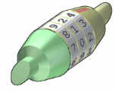
Permutation
A Permutation is an ordered Combination.
To help you to remember, think
"Permutation ... Position“
There are basically two types of permutation:
Repetition is Allowed
Such as the lock above. It could be "333".
No Repetition
For example the first three people in a running race. You can't be first and second.

Slide 17

Example :Permutations
without Repetition
What order could 16 pool balls be in?
After choosing, say, number "14" you
can't choose it again.So, your first
choice would have 16 possibilities and your next choice would then have 15 possibilities, then 14, 13, etc. And the total permutations would be:
16 × 15 × 14 × 13 × ... = 16! = 20,922,789,888,000
Maybe you don't want to choose them all, just 3 of them, so that would be only:
16 × 15 × 14 = 16! / 13! = 3,360
In other words, there are 3,360 different ways that 3 pool balls could be selected out of 16 balls.

Slide 18


Example :Permutations
without Repetition
The formula is written:
where n is the number of things to choose from, and you choose r of them.
Instead of writing the whole formula, people use different notations such as these:

Slide 19

Permutations of Selected Letters of a Word
a. How many different ways can three of the letters of the word BYTES be chosen and written in a row?
b. How many different ways can this be done if the first letter must be B?
Solution:
a. The answer equals the number of 3-permutations of a set of five elements. This equals

Slide 20
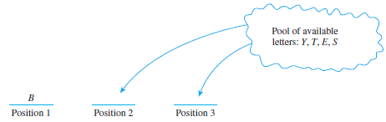

Permutations of Selected Letters of a Word
b.
Hence the answer is the number of 2-permutations of a set of four elements, which is

Slide 21
Permutations Around
a Circle
  The table has no ends to confer particular status, it doesn’t matter who sits in which chair.
  How many different ways can the diplomats be seated?
The formula is written:
(n-1)!
where n is the number of things
to choose.
A
F
B
5!
E
C
D

Slide 22
ADDITION AND DIFFERENCE RULE

Slide 23
The Addition Rule
  Theorem
  Suppose a finite set A equals the union of k distinct mutually disjoint subject A₁, A₂, A₃, …, A_{k}. Then
  N(A) = N(A₁) + N(A₂) + N(A₃) + … + N(A_{k})

Slide 24
The Addition Rule
Example: Counting Passwords with Three or Fewer Letters
  A computer access password consists of from one to three letters chosen from the 26 in the alphabet with repetitions allowed.
  How many different passwords are possible?
  Solution :
  Number of passwords of length 1 = 26
  Number of passwords of length 2 = 26 × 26
  Number of passwords of length 3 = 26 × 26 × 26
  ∴ 26 + 26² + 26³

Slide 25
The Difference Rule
  Theorem
  If A is a finite set and B is a subset of A, then
  N(A － B) = N(A) – N(B)
  If S is a finite sample space and A is an event in S, then
  P(A^{c}) = 1 – P(A).

Slide 26
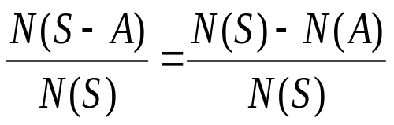
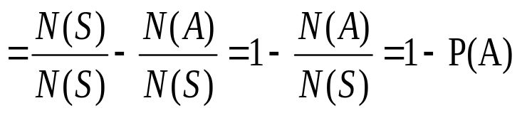
The Difference Rule
  Example:
  The PINs are made from exactly 4 symbols chosen from the 26 letters of the alphabet and the 4 digits, with repetitions allowed.
  How many PINs contain repeated symbols? 36⁴ – ₃₆P₄
  If all PINs are equally likely, what is the probability that a randomly . chosen PIN contains a repeated symbols?
  P( S – A ) =

Slide 27
Difference of Permutation
and Combination
In English we use the word "combination" loosely, without thinking if the order of things is important. In other words:
"My fruit salad is a combination of apples, grapes and bananas" We don't care what order the fruits are in, they could also be "bananas, grapes and apples" or "grapes, apples and bananas", its the same fruit salad.
"The combination to the safe was 472". Now we do care about the order. "724" would not work, nor would "247". It has to be exactly 4-7-2.
So, in Mathematics we use more precise language:
If the order doesn't matter, it is a Combination.
If the order does matter it is a Permutation.

Slide 28
Combination
An r-combination of elements of a set is an unordered selection of r element from the set.
There are also two types of combinations (remember the order does not matter now):
Repetition is Allowed: such as coins in your pocket (5,5,5,10,10)
No Repetition: such as lottery numbers (2,14,15,27,30,33)

Slide 29
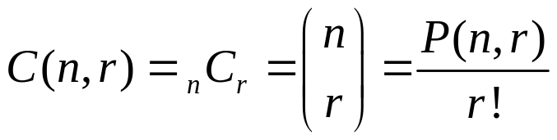
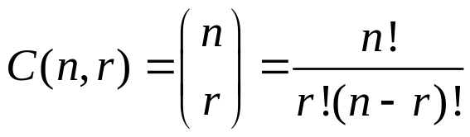
Combinations without
Repetition
  The number of subsets of size r ( or r-Combinations ) that can be chosen from a set of n elements, C(n,r), is given by the formula
  Or, equivalently
  Where n and r are nonnegative integers with r ≤ n.

Slide 30
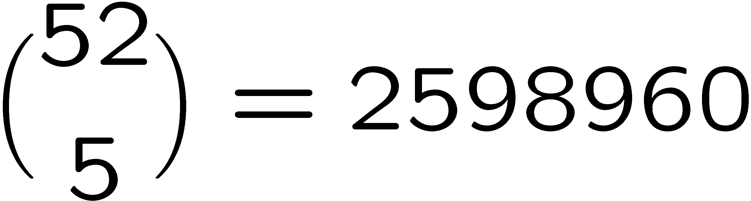
Example: Poker Hands
There are 52 cards in a deck.
Each card has a suit and a value
4 suits
13 values
Five-Card Draw is a card game in which each player is initially dealt a hand, a subset of 5 cards.
How many different hands?
(♠ ♥ ♦ ♣)
(2, 3, 4, 5, 6, 7, 8, 9, 10, J, Q, K, A)

Slide 31

Combinations with Repetition
The number of r-combinations with repetition allowed (multisets of size r) that can be selected from a set of n elements is
This equals the number of ways r objects can be selected from n categories of objects with repetition allowed.

Slide 32
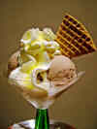
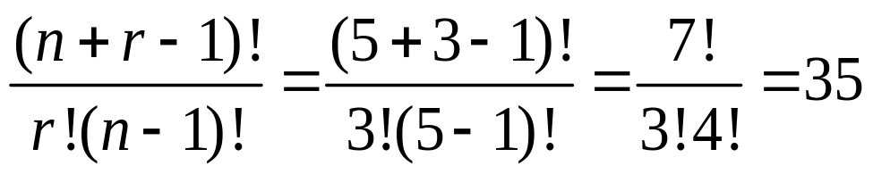
Example
Let us say there are five flavors of ice
cream: banana, chocolate, lemon,
strawberry and vanilla. You can have
three scoops.
How many variations will there be?
And just to be clear:
There are n = 5 things to choose from, and you choose r = 3 of them. Order does not matter, and you can repeat!

Slide 33
Exercise
A club is considering changing its by-laws. In an initial straw vote on the issue, 24 of the 40 members of the club favored the change and 16 did not. A committee of six is to be chosen from the 40 club members to devote further study to the issue.
How many of the committees will contain at least three club members who, in the preliminary survey, favored the change in the by-laws?

Slide 34




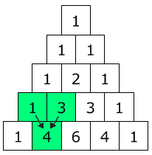







Pascal’s Triangle
There is such a formula find the coefficient from Pascal's Triangle
Each number is just the two numbers above
it added together (except for the edges,
which are all "1")

Slide 35

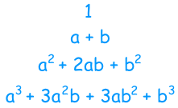
The Binomial Theorem
Given any real numbers a and b and any nonnegative integer n,
Let's look at all the results we got before, from (a+b)⁰ up to (a+b)³:

Slide 36
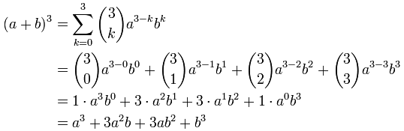
Example: Binomial

Slide 37
More Example: Binomial
What is (x+5)⁴
Then write down the answer (including all calculations, such as 4×5, 6×5², etc):
(x+5)⁴ = x⁴ + 20x³ + 150x² + 500x + 625
Start with exponents: | x⁴5⁰ | x³5¹ | x²5² | x¹5³ | x⁰5⁴
Include Coefficients: | 1x⁴5⁰ | 4x³5¹ | 6x²5² | 4x¹5³ | 1x⁰5⁴

Slide 38
Reference
Susanna S.Epp. (2015). Discrete Mathematics with Applications.5th edition. Thomson Brooks/Cole. USA. ISBN: 9780534359454

